Slide 1


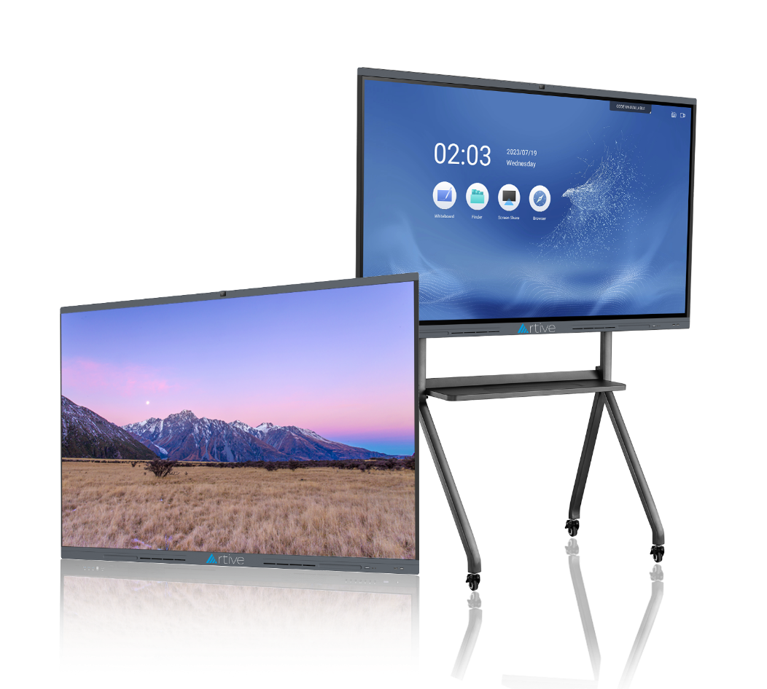



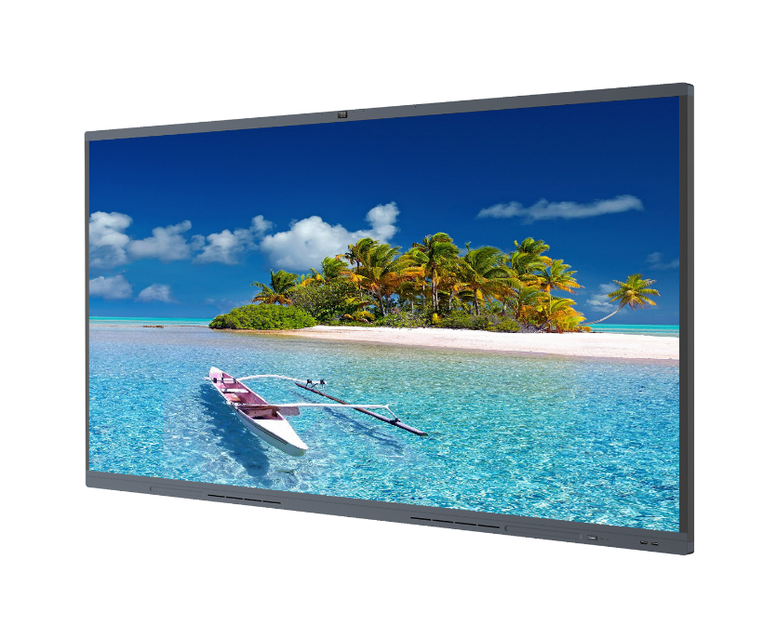
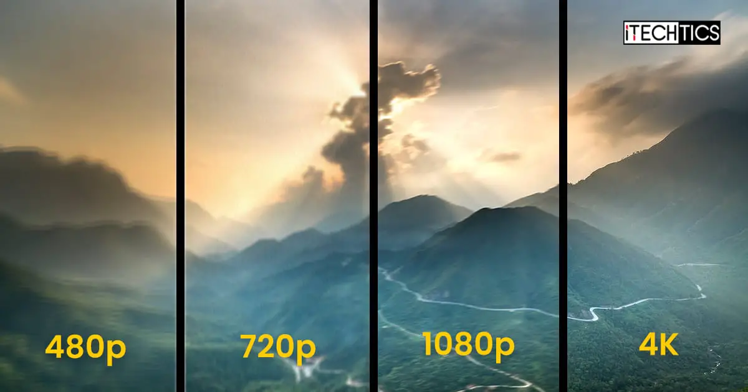
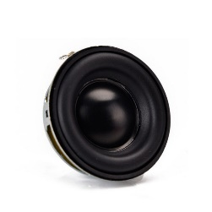

Increase
Engagement in
Collaborative
Learning
Interactive Flat Panel
Display | Write | Projection Screen | Microphone | Camera | Speaker
In today’s continuously evolving workplace, the need for communication and collaboration is more important than ever. Digital technology is constantly reshaping the way people work. An Interactive Display is a tool that enables the user to run their meetings or teach their students in an innovative and creative way.
Interactive Display offers active learning through student engagement opportunities and Multi-Touch capabilities let groups of students edit and experience onscreen content as a team and brainstorm. Showing videos and slides can be enhanced to allow students to become involved in the learning process.
4K Ultra Image
High power audio system
Auto framing camera
+88 02223374052
+88 02223374052
info@artive.com.bd
www.artive.com.bd

Slide 2


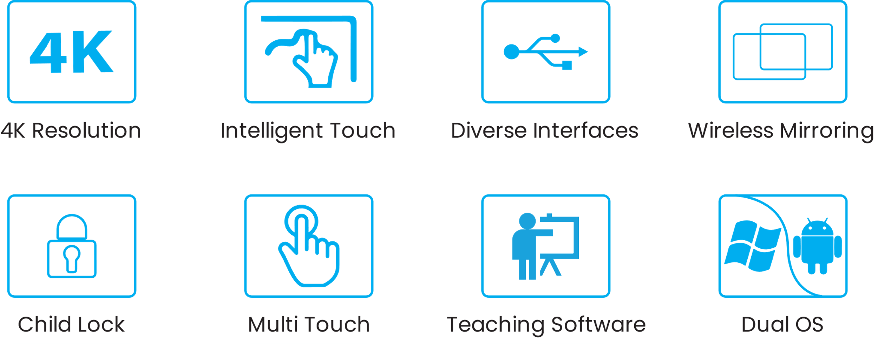
Key Features
Android 11, 8 GB RAM, 128GB ROM, 2.2 GHz CPU
High Power Speaker, 8-Microphone Array
12 Million Wide-Angle Auto Framing & Sound Tracking Camera
Mirror Back and Control Connected Laptop/PC over Wireless and Wired LAN
Write from connected SMART Devices
Sharing Documents over the Wireless & Bluetooth
9-Screen Concurrent Display over the Wi-Fi
Dual Split Screen Support for Writing & Presentation Concurrently
Handwriting to Auto Type
Video Conference using popular VC Software
01 Faster Response Time
02 Logical Operation
03 Animated & Integrated Style
The system responds 10% faster than the previous versions
Input, exit, writing, erasing, feedback are some of the operating tools that provide smooth operation
A translucent purple / blue / green interface delivers a calm and an attractive vibe making the human-computer interaction pleasant
04 Elegant Visual Interface
05 Concise and Focused
06 Online Software Upgrade
Controls, floating layers, buttons are guided by purple and blue. Icons and control shapes are normalized.
Interface content is clear. Integrate familiar content into the interface. Get rid of all the clutter.
Online software upgrades ensure the optimization and provide the latest operational experience
+88 02223374052
info@artive.com.bd
www.artive.com.bd

Slide 3
Specifications
FEATURES |  | ATL-11D2100 | ATL-11D2110
Display | Size | 100″ LED Backlight | 110″ LED Backlight
 | Active Area (mm) | 2158.8(H) * 1214.3(V) | 2436.48 (H) * 1370.52 (V)
 | Pixel Pitch (mm) | 0. 5622 × 0.5622 | 0.2115 x 0.6345
 | Bezel Color | Aluminum Frame Gray
 | Back Light | Direct Type LED
 | Resolution | 3840*2160 /60hz
 | Aspect Ratio | 16:09
 | Contrast Ratio | 1200:1 (Typ.)
 | Dynamic Contrast Ratio | 4000:1
 | Colors | 1.07 Billion Colors
 | Brightness | 450cd/m2
 | Viewing Angle | 178°
 | Glass Hardness | Mohs-7 Level
 | Screen Surface | Anti-Glare Glass
Panel | Touch Technology | IR Touch
 | Multi Touch | 20 Points in Windows
 | Multi Writing | 20 Points in Android
 | Auto-Calibrate | Yes
 | Anti-Light | Yes
 | Minimum Object Size (mm) | 3
 | Touch Precision | 1 mm (Over 90% Area)
 | Response Time | <8 ms
 | System Support | Windows 7/8/10/11; Android; Mac; Linux; Chrome OS
Front Interface | Front Ports | HDMI; USB3.0 * 2 lines (Public for both Android & PC); Touch; Type-C
 | Front Keys | Power ON/OFF
 | Speaker | 15W*2 Treble +20W Bass
Bottom Interface | AUDIO IN | 1
 | VGA | 1
 | DP | 1
 | USB 2.0 | 1
 | USB 3.0 (touch) | 1
 | RS232 | 1
 | COAX | 1
 | Line OUT | 1
+88 02223374052
info@artive.com.bd
www.artive.com.bd

Slide 4
FEATURES |  | ATL-11D2100 |  | ATL-11D2110
Rear Interface | HDMI IN 2.0 | 2
 | HDMI OUT | 1
 | LAN-Port IN/OUT | 2
 | USB 3.0 (touch) | 1
 | HDMI OUT 2.0 | 1
 | USB Type-C 3.1 | 1
 | Public USB-A 3.0 | 2
 | Windows OPS Slot | 80-Pins OPS slot
 | Wi-Fi Standard | Wi-Fi 6 (2.4G+5G) Dual Band
 | Bluetooth Version | 5
Multi-Media | Camera | Built-in 12 Million Wide-Angle Auto Framing & Sound Tracking Camera
 | Opposite Angle | 92°± 3°(Ø7.2mm)
 | Mic | 8 Array Mic Covering Distance 10m
Operating System | Android Version | Android 11.0
 | CHIP | Amlogic 311D2
 | CPU | A73*4 + A53*4 (4 Core+4 Core) 2.28GHz Octa Core Processor
 | GPU | G52 MP8
 | RAM | 8GB DDR4
 | ROM | 128GB
 | Compliant | Windows; Mac; Linux; Chrome OS
 | Decoding Resolution | Support 4K H.265 Decoding
 | Video Format | Support VP9、HEVC/H.265、MPEG1/2、MPEG4、Sorenson H.263、H263、
 | Image Format | Support JPG / JPEG / BMP / PNG and Other Image Formats
 | Audio Format | Support MPEG1/2、AC3、EAC3(DDP)、AAC、HEAAC、WMA、WMA10 pro
Structure | Net Weight (kg±2) | 91 | 123
 | Gross Weight (kg±2) | 122 | 175
 | Overall Size (mm) | 2215.8*107.8*1340.8 | 2499.4*170.8*1500.7
 | Carton Size (mm) | 2395*305*1580 | 2670*330*1880
 | VESA | 1000*400 | 1000*800
+88 02223374052
+88 02223374052
info@artive.com.bd
www.artive.com.bd

Slide 5
FEATURES |  | ATL-11D2100 |  | ATL-11D2110
Electrical | Input Voltage | 100-240V AC
 | Switch On or Off | Yes
 | Power Consumption (Standby) | <0.5W | <1W
 | Power Consumption | Operation <650W | Operation <750W
 |  | Eco <75W | Eco <75W
Accessories | WIFI dongle *1pcs; No Ink Pen * 2pcs, Remote Control *1pcs, 1.8m Power Cord *1pcs, 2.0m HDMI Cable *1pcs, 1.5m USB Touch Cable *1pcs; Wall Mount Kit
FEATURES |  | ATL-11D265 | ATL-11D275 |  | ATL-11D286
Electrical | Input Voltage | 100-240V AC
 | Switch On or Off | Yes
 | Power Consumption (Standby) | <0.5W
 | Power Consumption | Operation <290W |  | Operation <420W |  | Operation <500W
 |  | Eco <75W |  | Eco <75W |  | Eco<75W
Accessories | WIFI dongle *1pcs; No Ink Pen * 2pcs, Remote Control *1pcs, 1.8m Power Cord *1pcs, 2.0m HDMI Cable *1pcs, 1.5m USB Touch Cable *1pcs; Wall Mount Kit
Ordering Information
PART NO. | DESCRIPTION OF ITEMS | PRODUCT DIMENSION (MM) | G. W. (KG) | N. W. (KG) | PACKING DIMENSION (MM)
ATL-11D2100 | 100 Inch All-in-One Interactive Flat Panel | 2215.8*107.8*1340.8 | 122 | 91 | 2395*305*1580
ATL-11D2110 | 110 Inch All-in-One Interactive Flat Panel | 2499.4*170.8*1500.7 | 175 | 123 | 2670*330*1880
+88 02223374052
+88 02223374052
info@artive.com.bd
www.artive.com.bd

